Slide 1
UNIT-3: Overview of the Course
Supervised Learning: Classification
Introduction
Classification techniques:
K-nearest Neighbour (KNN)
Decision Tree Algorithm
Support Vector Machine
Naïve Bayes,
Logistic regression
Recommendation System: Content based and Collaborative techniques.

Slide 2
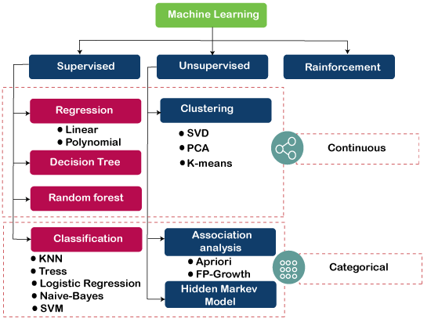
UNIT-3: Supervised Learning: Classification

Slide 3
Classification: Introduction
It is called supervised learning because the process of learning from the training data by a machine can be related to a teacher supervising the learning process of a student who is new to the subject.
Here, the teacher is the training data.
Training data is the past information with known value of class field or ‘label’.
Hence, we say that the ‘training data is labelled’ in the case of supervised learning.
Contrary to this, there is no labelled training data for unsupervised learning.
Some more examples of supervised learning are as follows:
Predicting whether a tumour is malignant or benign.
Price prediction in domains such as real estate, stocks, etc.
Test results of newly admitted patients are to classify them as high-risk or low-risk patients.

Slide 4
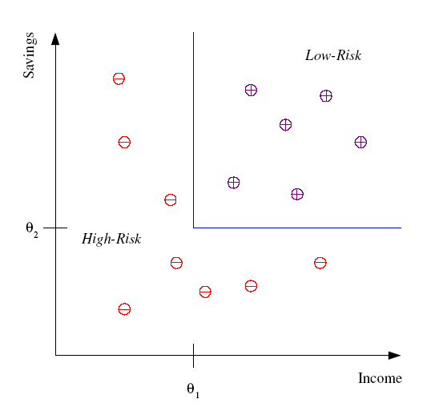
Classification
Example: Credit scoring
Differentiating between low-risk and high-risk customers from their income and savings
Discriminant: IF income > θ₁ AND savings > θ₂
THEN low-risk ELSE high-risk

Slide 5
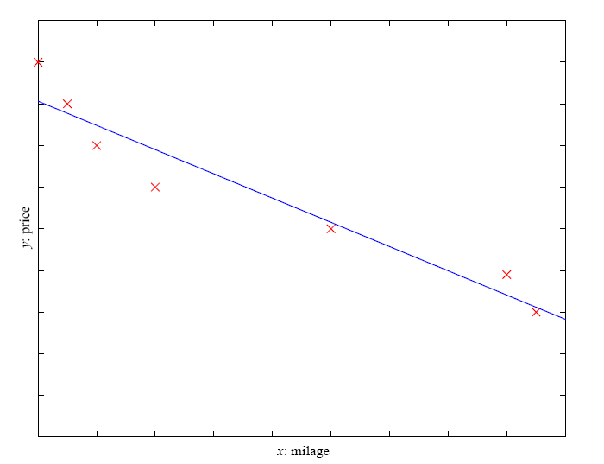
Regression
Example: Price of a used car
x : car attributes
y : price
y = g (x | θ )
g ( ) model,
θ parameters
y = wx+w₀

Slide 6
KNN Algorithm:
The k-nearest neighbors (KNN) algorithm is
a simple,
easy-to-implement
supervised machine learning algorithm.
K-NN algorithm assumes the similarity between the new case/data and available cases and put the new case into the category that is most similar to the available categories.
K-NN algorithm stores all the available data and classifies a new data point based on the similarity.
K-NN algorithm can be used for Regression as well as for Classification.

Slide 7
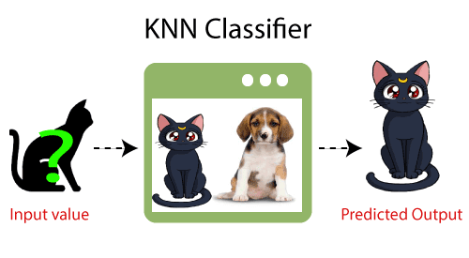
Example: Suppose, we have an image of a creature that looks similar to cat and dog.
So for this identification, we can use the KNN algorithm.
Our KNN model will find the similar features of the new data set and based on the most similar features, it will put it in either cat or dog category.

Slide 8
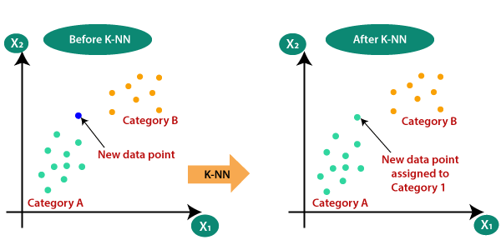
Why do we need a K-NN Algorithm?
Suppose there are two categories, i.e., Category A and Category B, and we have a new data point x1 (Input Value).
This new data point will lie in which of these categories?.
To solve this type of problem, we need a K-NN algorithm. Consider the below diagram:

Slide 9
Algorithm: The working of KNN can be explained on the basis of the
below algorithm:
Step-1: Select the number K of the neighbors.
Step-2: Calculate the Euclidean distance of K number of neighbors
Step-3: Take the K nearest neighbors as per the calculated Euclidean
distance.
Step-4: Among these k neighbors, count the number of the data points
in each category.
Step-5: Assign the new data points to that category for which the
number of the neighbor is maximum.
Step-6: Our model is ready.

Slide 10
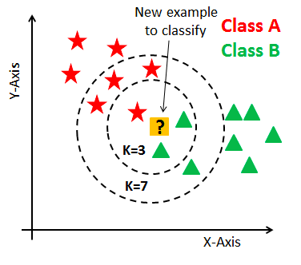

Slide 11
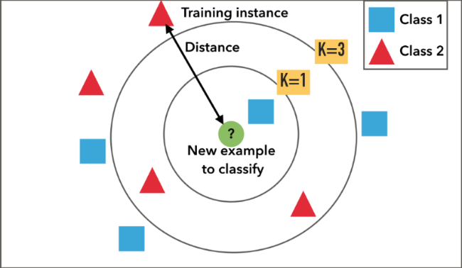

Slide 12
Example:- We have data from the questionnaires survey and objective testing with two attributes:
Acid Durability and
Strength
To classify whether a paper tissues is good or not?
Here is four training data set is given .
Sr. No. | X1=Acid Durability (In Seconds) | X2=Strength (In Kg/square meter) | Y=Classification
01 | 7 | 7 | Bad
02 | 7 | 4 | Bad
03 | 3 | 4 | Good
04 | 1 | 4 | Good

Slide 13
Training (Sample) data set=(X1, X2) =(7,7),(7,4), (3,4), (1,4)
Now factory produces a new paper tissues that pass laboratory test with X1=3 and X2=7.
Testing Sample data=(3,7)
Without expensive survey, Can we guess/classify this new paper tissues is Good or Not Good(Bad)?
So , we applying KNN algorithm.
Step1:- Determine , K= No. of nearest neighbors.
Suppose K=3.
Step2: Calculate the distance between the query-instance (Testing sample) and all the training samples.
Coordinate of query-instance is =(3,7).
So we compute Euclidian Distance as follows:

Slide 14
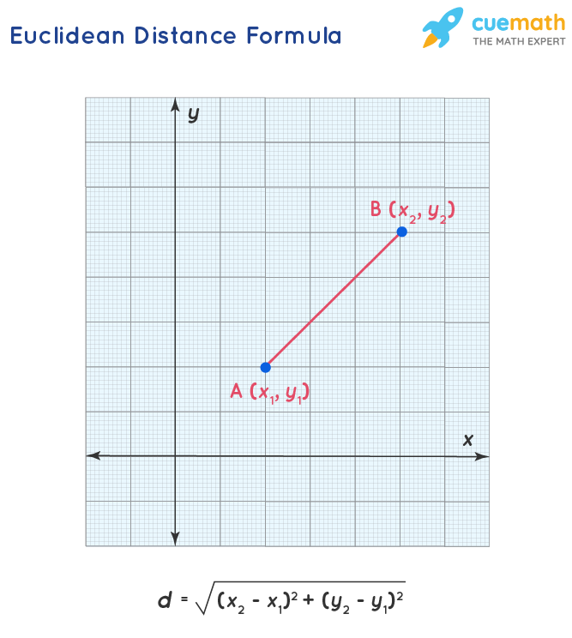

Slide 15
1. (7,7),(3,7)=√(7-3)2+(7-7)2=√16=4
2. (7,4), (3,7)= √(7-3)2+(4-7)2=√25=5
3. (3,4), (3,7)= √(3-3)2+(4-7)2=√9=3
4. (1,4), (3,7)= √(1-3)2+(4-7)2=√13=3.6
Step3:-Sorting the distance in Ascending order and determine nearest neighbors based on K-th minimum distance.
Step4: Count the No. of Nearest Neighbors in each category.
We have Good=2 and Bad=1, since 2>1, then we conclude that a new paper tissues with X1=3 and X2=7 should be included in Good Category.
X1 | X2 | Euclidian Distance ( in Ascending Order) | Is it included in nearest neighbors | Category of Nearest Neighbors
3 | 4 | 3 | Yes | Good
1 | 4 | 3.6 | Yes | Good
7 | 7 | 4 | Yes | Bad
7 | 4 | 5 | No | Bad

Slide 16
Conclusion:
We have 2 Good NN and 1 Bad NN, since 2>1, then we conclude that a new paper tissues with X1=3 and X2=7 should be included in Good Category.

Slide 17
The KNN Algorithm:
1. Load the data
2. Initialize K to your chosen number of neighbors
3. For each example in the data
3.1 Calculate the distance between the query example and the current example from the data.
3.2 Add the distance and the index of the example to an ordered collection
4. Sort the ordered collection of distances and indices from smallest to largest (in ascending order) by the distances
5. Pick the first K entries from the sorted collection
6. Get the labels of the selected K entries
7. If regression, return the mean of the K labels
8. If classification, return the mode of the K labels

Slide 18
How to select the value of K in the K-NN Algorithm?
Below are some points to remember while selecting the value of K in the K-NN algorithm:
There is no particular way to determine the best value for "K", so we need to try some values to find the best out of them.
The most preferred value for K is 5.
A very low value for K such as K=1 or K=2, can be noisy and lead to the effects of outliers in the model.
Large values for K are good, but it may find some difficulties.

Slide 19
Advantages of KNN Algorithm:
It is simple to implement.
It is robust to the noisy training data.
It can be more effective if the training data is large.
Disadvantages of KNN Algorithm:
Always needs to determine the value of K which may be complex some time.
The computation cost is high because of calculating the distance between the data points for all the training samples.
The algorithm gets significantly slower as the number of examples and/or predictors/independent variables increase.

Slide 20
Website:-
1. https://www.javatpoint.com/k-nearest-neighbor-algorithm-for-machine-learning.
2. https://medium.com/@adi.bronshtein
3. https://www.analyticsvidhya.com/blog/2021/05/knn-the-distance-based-machine-learning-algorithm
4.https://www.tutorialspoint.com/
5. https://towardsdatascience.com/
6.https://people.revoledu.com/kardi/tutorial/KNN/KNN_Numerical-example.html
7. https://medium.com/analytics-vidhya
8. https://www.geeksforgeeks.org/

